Slide 1
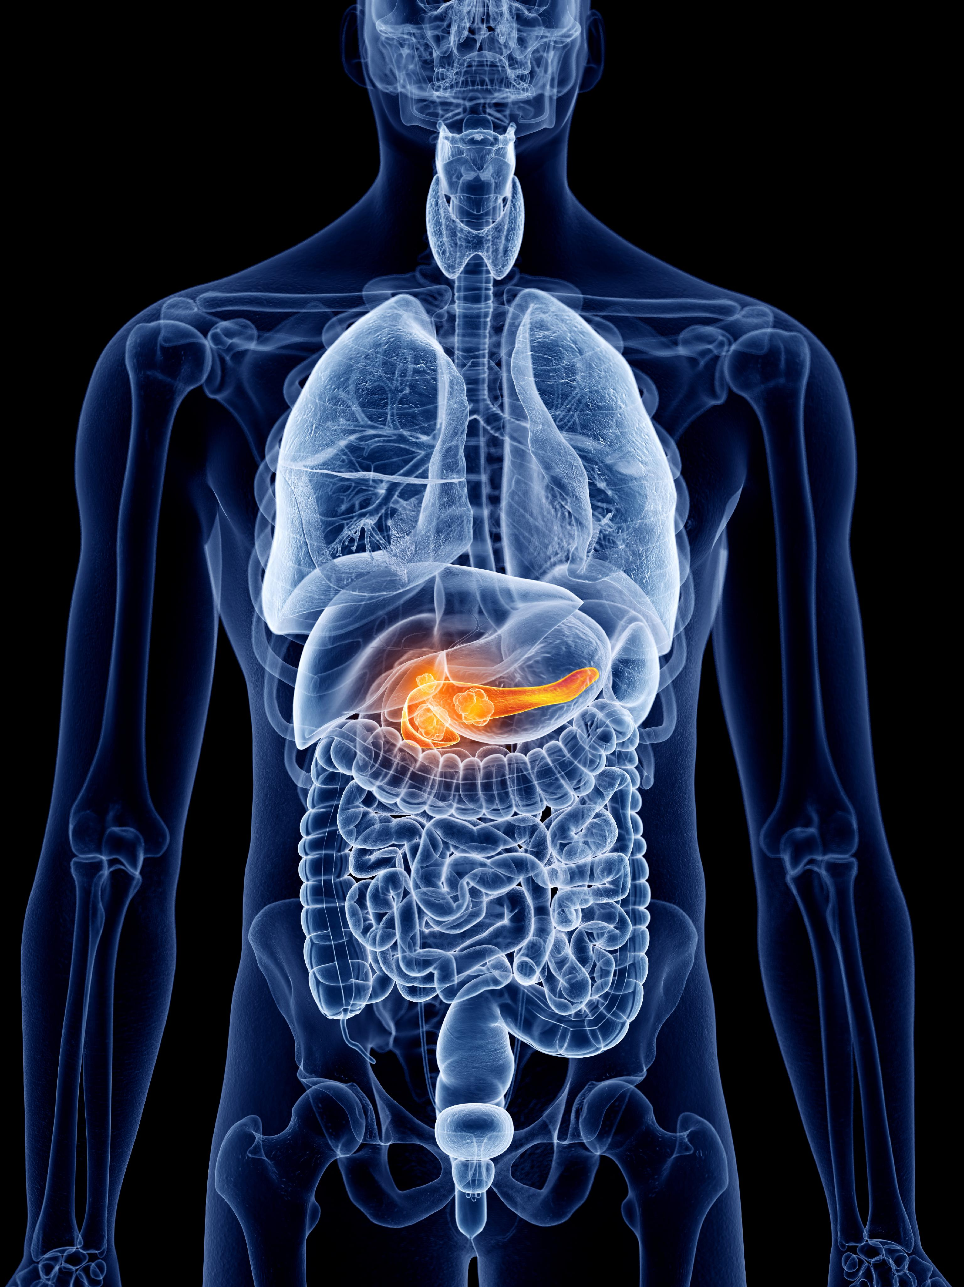
Pancreatic Cancer Classification Using ML and DL

Slide 2

DEPARTMENT OF MCA
Project Title :Pancreatic Cancer Classification Using ML And DL
Project Guide : Ms.Bhargavi k
Presenting by:Manjunath C S
P19DU22S126118

Slide 3
Table of contents
Introduction
Objectives
Existing System
Proposed System
Architecture Diagram
Methodology
Expected Result
Conclusion

Slide 4
INTRODUCTION
Pancreatic cancer is a formidable and often devastating disease that arises within the pancreas, an essential organ located deep within the abdomen.
This form of cancer is notorious for its aggressive nature, challenging diagnosis, and limited treatment options, making it one of the most formidable malignancies in modern medicine.
Pancreatic cancer develops when cells within the pancreas undergo uncontrolled growth and division forming.Yet, with ongoing research, there is hope for breakthroughs in early detection, personalized therapies, and innovative approaches that could improve outcomes for those affected by this devastating disease.

Slide 5
OBJECTIVES
Improving Early Detection: Utilizing Machine Learning (ML) and Deep Learning (DL) techniques to enhance early detection of pancreatic cancer, a critical aspect for improving survival rates.
Accurate Classification: Employing advanced ML algorithms like Random Forest Classifier and Naive Bayes to achieve high accuracy in classifying patients into categories such as Control, Benign, and Pancreatic Ductal Adenocarcinoma (PDAC).
Enhancing Diagnostic Performance: Using Convolutional Neural Networks (CNNs) for image-based diagnosis, achieving high training and validation accuracy, contributing to more reliable cancer detection methods.

Slide 6
EXISTING SYSTEM
Existing systems for pancreatic cancer classification use Machine Learning (ML) models like Random Forest and SVM to analyze biomarkers, while Deep Learning (DL) approaches like Convolutional Neural Networks (CNNs) focus on medical imaging.
They integrate clinical and imaging data for robust predictions but face challenges with limited datasets and high variability. Continuous improvements aim to enhance reliability and applicability.

Slide 7
PROPOSED SYSTEM
The integration of both Machine Learning and Deep Learning techniques, combined with numerical and image data analysis, results in improved diagnostic accuracy, reducing the likelihood of misdiagnosis and false negatives.
The proposed system can leverage both numerical and image data, allowing for a more holistic and comprehensive analysis of medical conditions, which can be especially valuable in complex diseases like pancreatic cancer.

Slide 8
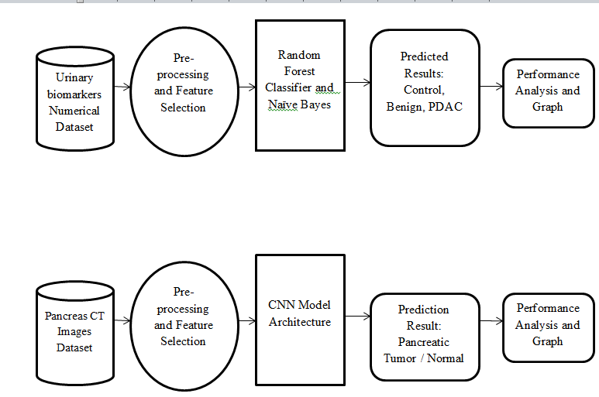
ARCHITECTURE DIAGRAM

Slide 9
METHODOLOGY
Dataset Selection:A critical step is selecting a dataset with features that can help differentiate between pancreatic cancer types.
Preprocessing:Data Cleaning, Remove or handle missing values. Splitting the Dataset: Split the dataset into training and testing sets (e.g., 70% training and 30% testing).
Train the Model: Train the RF algorithm on the training data. In this project, the Random Forest achieved a 100% training accuracy.
Test the Model: Evaluate the model on the testing set. The model yielded a 99.2% test accuracy, indicating robust generalization.
Model Evaluation:Accuracy: The accuracy score is a basic performance metric. In the research, RF achieved 100% training accuracy and 99.2% test accuracy, indicating a highly effective model.

Slide 10
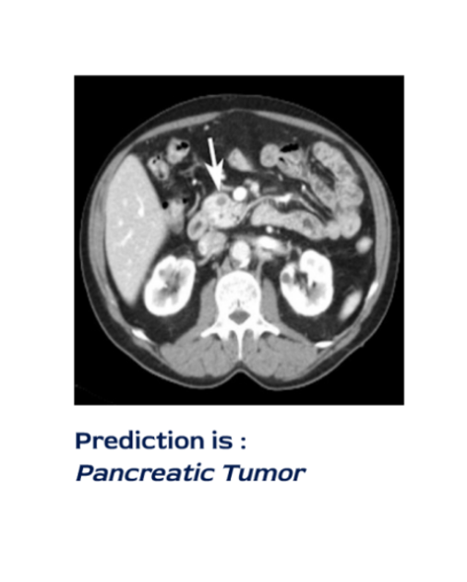
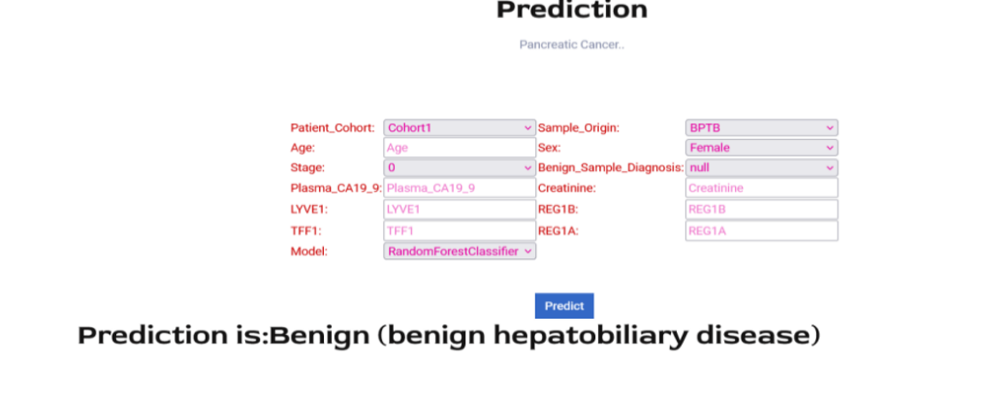
EXPECTED RESULT

Slide 11
FUTURE SCOPE
Extended Dataset Collection: Expanding the dataset to include a more diverse range of patient profiles and health indicators can lead to a more robust and generalized system. Collaborating with multiple healthcare institutions for data collection is one way to achieve this.
Mobile Application Development: Creating a user-friendly mobile application that enables healthcare providers to access the system's diagnostic capabilities on handheld devices, facilitating point-of-care diagnosis and remote consultations.
Machine Learning and Deep Learning Advancements: Staying up-to-date with the latest advancements in machine learning and deep learning techniques, and implementing them to enhance the system's performance and accuracy.

Slide 12
CONCLUSION
In conclusion, this project underscores the transformative potential of machine learning and deep learning in the fight against pancreatic cancer.
With ongoing research, collaboration, and technological advancement, deep learning could become an indispensable tool in revolutionizing pancreatic cancer care, offering hope for improved survival rates and quality of life for patients.

Slide 13
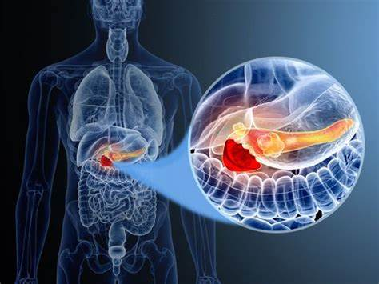
THANK YOU

